Slide 1



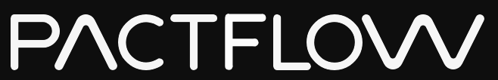

Brought to you by
Notes:
In the context of application modernisation - monolith to microservices, distributed systems and large teams.

Slide 2
BACKGROUND
Agenda
Plan for today
Problem
How Pact works
Demo
Q & A
Brought to you by

Slide 3
VISION
Our vision is to transform the way teams test and release distributed systems.
Integration testing is hard...
Brought to you by

Slide 4




BACKGROUND
The numbers
Four key indicators of high performing organisations¹
Need < 1 day lead time for changes = 106x faster time from commit -> deploy
Are able to deploy on demand = 208x more deployments
Have change failures rates < 15% = 7x lower change failure rates
Can restore services within 1 hour = 2604x faster MTTR
¹ Data from the DORA 2019 State of DevOps report
Brought to you by
Notes:
We know what good looks like. The state of devops
In addition, Automated deployments (to test or prod, including automated environment provisioning) are associated with ~70% of elite performers

Slide 5
BACKGROUND
The numbers
Challenges facing the market
Only 20% of companies are “elite” performers¹
81% of teams spend a third of their time or more on fixing environments²
36% of teams are impacted by wait times and cost of test environments²
76% spent one third of their time or more managing test data²
¹ Data from the DORA 2019 State of DevOps report
² Data from a Capgemini report on continuous testing in March 2019
Brought to you by

Slide 6
ABOUT PACTFLOW
In 2013 Pact (an Open Source tool) was created to solve this problem. In 2019, we launched Pactflow to enable organisations to do this at scale.
Brought to you by

Slide 7
ABOUT PACTFLOW
Journey
How we got here
Pact created on a client project at realestate.com.au to solve problems testing microservices
Huge growth in popularity and language support (.NET, Go, JS, Python etc.)
🚀 Launch of Pactflow: a commercial project to solve integration testing at scale
2013
2015 - 2016
2019
2014
Dec 2016 - 2018
2020+
Pact Open Sourced (Ruby, JVM), initial adoption. Microservices becomes “a thing”
MVP: Launch of the “Hosted Pact Broker” - an early MVP of Pactflow. ~1000 signups
Goal: Sustainable business
>1500 customers
Solving bigger problems
In Product + OSS

Slide 8










HOW WE TEST MICROSERVICES NOW
The old way...
Why this is hard
Slow
Fragile
Test data management
Test environment management
Coverage?
All-at-once painful deployments
Teams wait on build queues
JSON/HTTP
JSON/HTTP
API Gateway
JSON/HTTP
JSON/HTTP
Microservice A
Microservice B
JSON/HTTP
#1
#2
#3
#4
#5
JSON/HTTP
JSON/XML
Microservice C
MQ

Slide 9
HOW WE TEST MICROSERVICES NOW
Scaling
Developer idle time (queues)
Build time
Risk associated with change
Cost / Complexity / Time
# Environments
Teams + Components
Linear increase in teams and components results in exponential increase in other factors
Number teams / components
Notes:
We find that we have Cohesive services, loosely coupled (want) but have cohesive teams, tightly coupled by services (got)

Slide 10
HOW WE TEST MICROSERVICES NOW
Where we went wrong
Cause and effect
Test and/or Release coupling
Environment management vs developer idle time
Slower pipeline leading to batching
Batching increases failure and defect rates
Increased deployment risk
Separate testing teams introduced
“Release Manager” introduced to govern the entire release process
Tech debt accumulation
Approach for monoliths does not work for distributed systems
Brought to you by
Notes:
Our teams were able to build independently, but were forced to collaborate closely in order to ship;
We had to manage and pay for an exponential amount of environments, or wear the cost of additional developer idle time;
Our delivery pipeline has grown linearly in time resulting in batching changes together;
Batching has resulted in increased failure and defect rates;
Integration tests failure results in disproportionately more time debugging them;
Deployments are riskier than when we were continuously shipping the original monolith;
The role of “Tester” emerged, whose job was to manually test features in fixed environments and fix build issues instead of coaching and doing exploratory testing;
The role of “Release Manager” emerged, to govern the entire release process;
Tech debt has accumulated as a result of these pressures.
We used the same tools and approaches that worked for monoliths and applied it to our new world

Slide 11
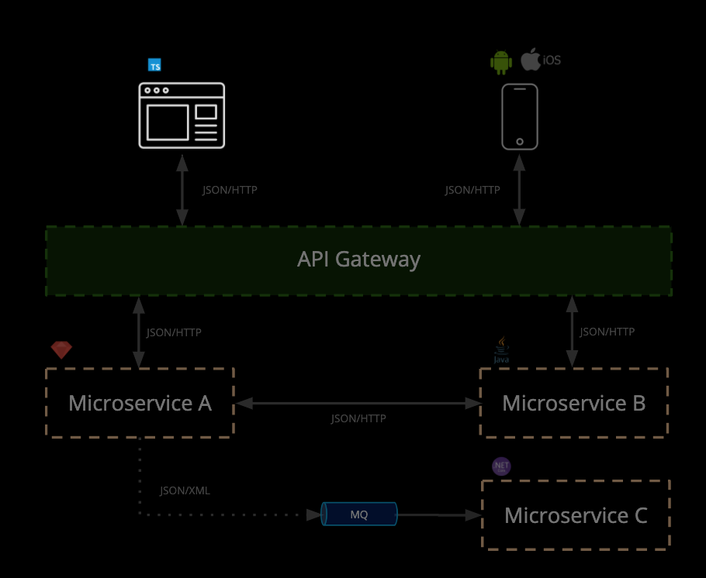
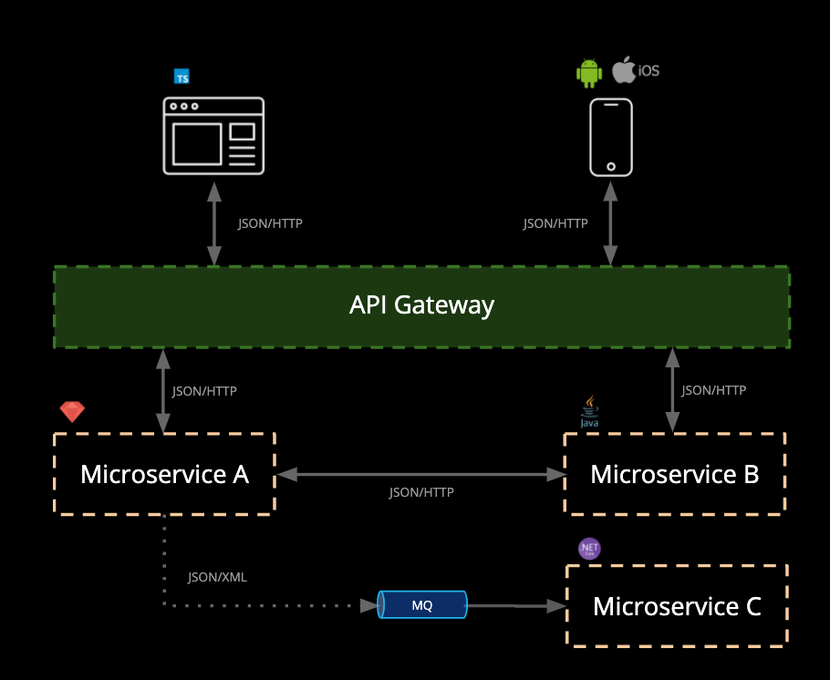
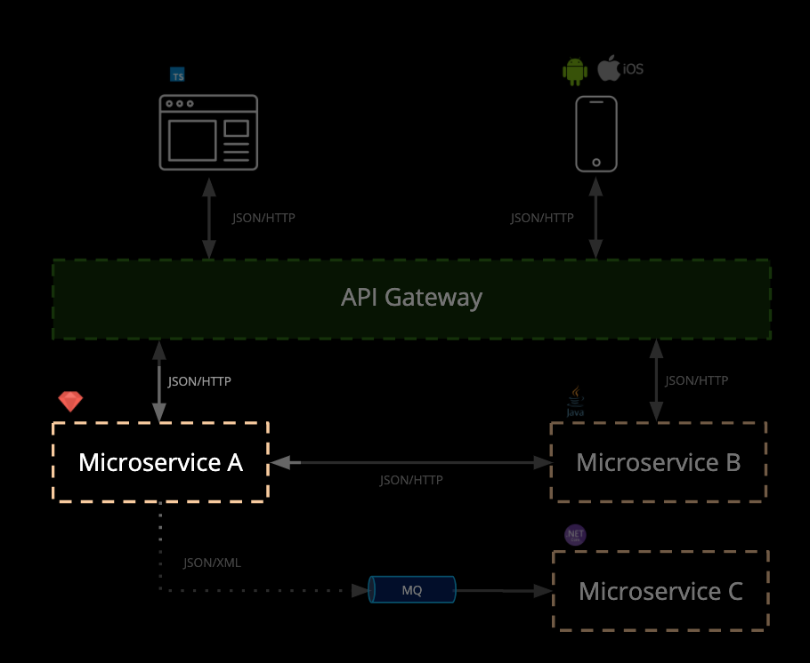
HOW IT SHOULD BE DONE
What is Pact?
Microservice testing made easy
Benefits:
Focus on testing a single integration at a time - without having to deploy
No dedicated test environments
Get fast, reliable feedback
Tests that scale linearly
Deploy services independently

Slide 12
PRODUCT
What is Pact?
Microservice testing made easy
Pact is an Open Source tool that makes it easy to test microservices quickly, independently and release safely.
Pact is already used by thousands of companies worldwide.
Use cases:
Javascript web applications (e.g. React)
Native mobile applications
RESTful microservices with JSON and XML
Asynchronous messaging (e.g. MQ)
JSON/HTTP
JSON/HTTP
API Gateway
JSON/HTTP
JSON/HTTP
Microservice A
Microservice B
JSON/HTTP
JSON/XML
Microservice C
MQ

Slide 13
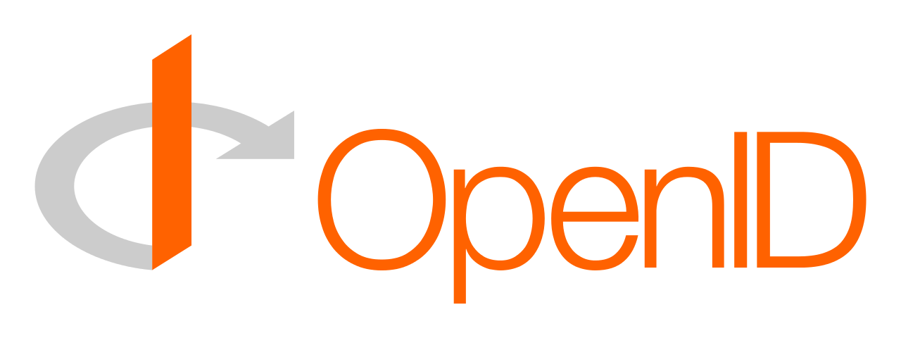






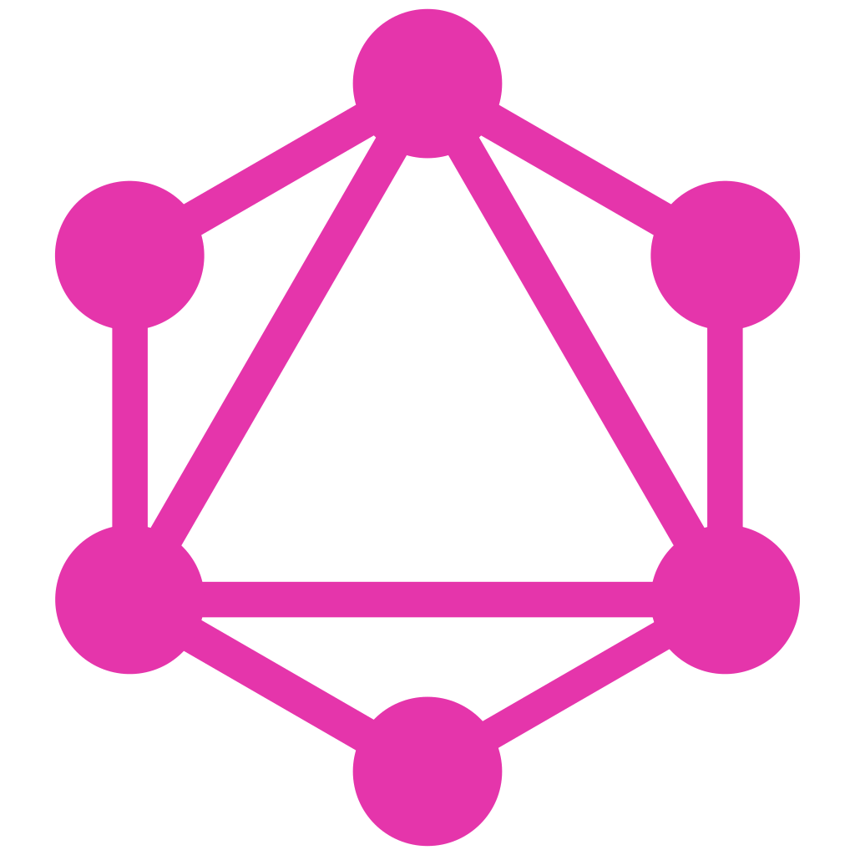
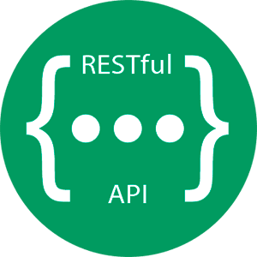

PRODUCT
Pactflow
Contract-testing at scale
Pactflow’s microservices continuous delivery platform
Collaborate with Pact and Spring Cloud Contract across many teams
Fully managed and hardened for scale
Gain insights into API integration issues quickly
Integrates with your tools + workflow
Orchestrate complex build, test and deployment pipelines
...and more
Security, Identity + Access Management
Collaboration
Tools
Automation
Integrations
Protocols
Broker
Insights
MQ
Pact + OSS Tooling

Slide 14








PRODUCT
Open Source
...and in your preferred language
Brought to you by

Slide 15
BACKGROUND
The numbers, revisited
How Pactflow supports high performing organisations
Need < 1 day lead time for changes
Are able to deploy on demand
Have change failures rates < 15%
Can restore services within 1 hour
Pact’s “consumer driven” contracts enable APIs to evolve quickly and safely
Deploy services independently and confidently using Pact’s can-i-deploy tool
Pact tests are focussed, scale linearly and cover more of your API in less time
Roll forward, not back - Pact tests run fast and don’t need E2E environments
Brought to you by
Notes:
Needs to answer/demonstrate
No need for test environments
Can-i-deploy (Pactflow)

Slide 16
DEMO
HOW PACT WORKS
Brought to you by

Slide 17
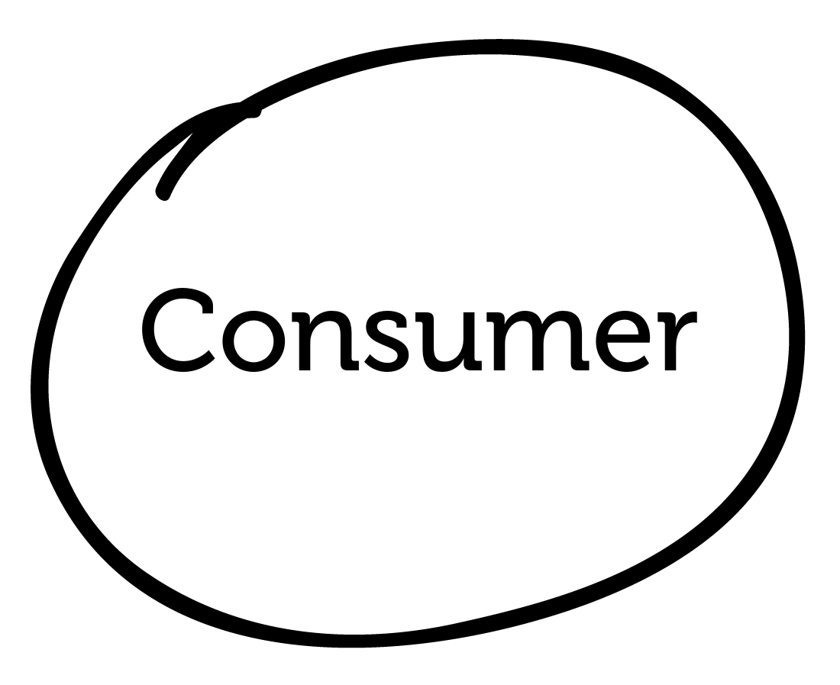
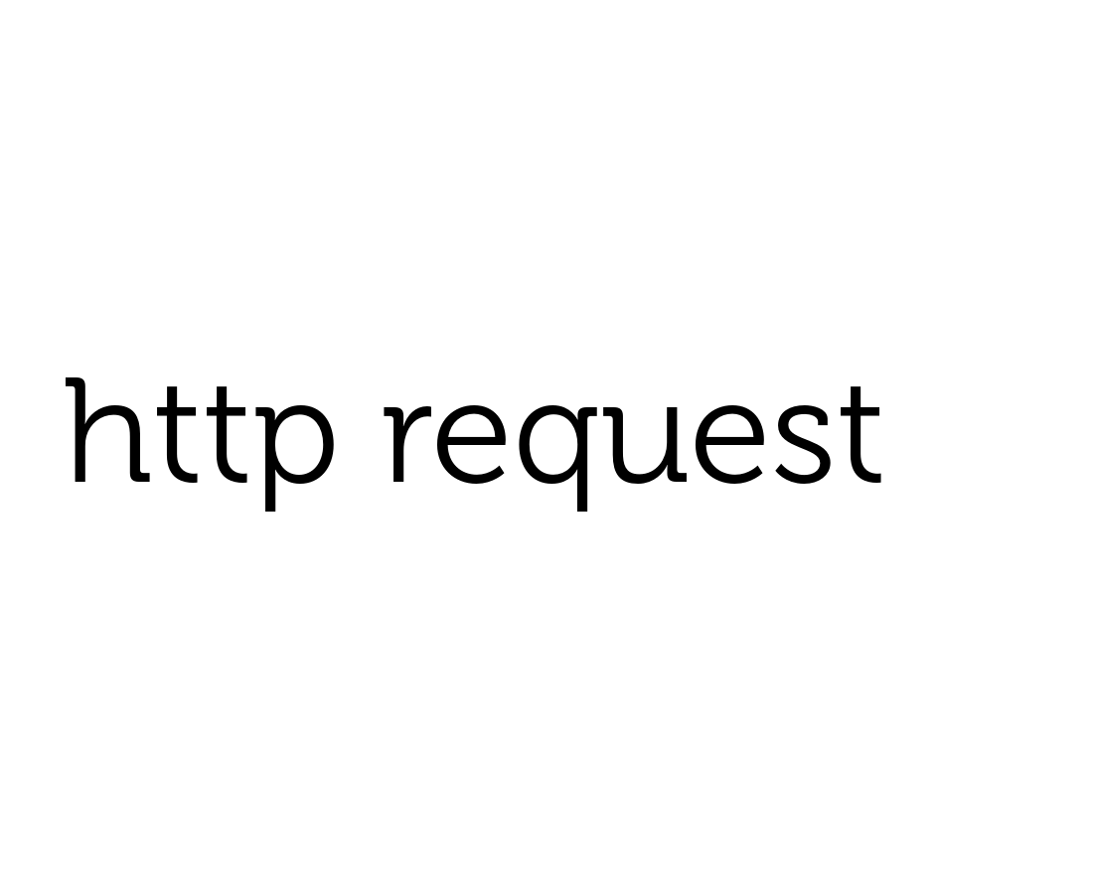
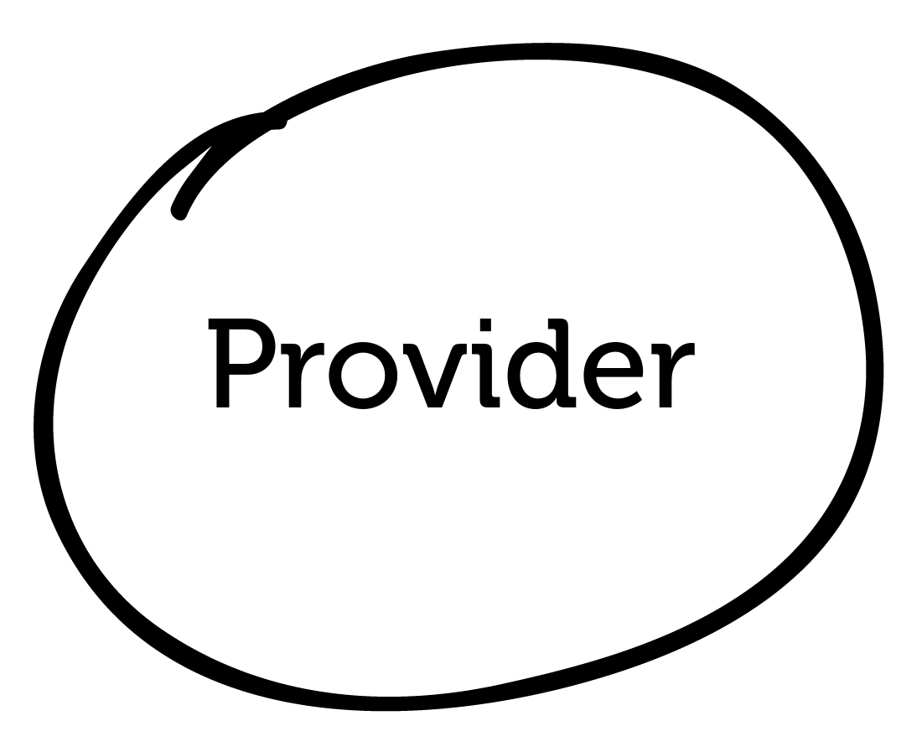

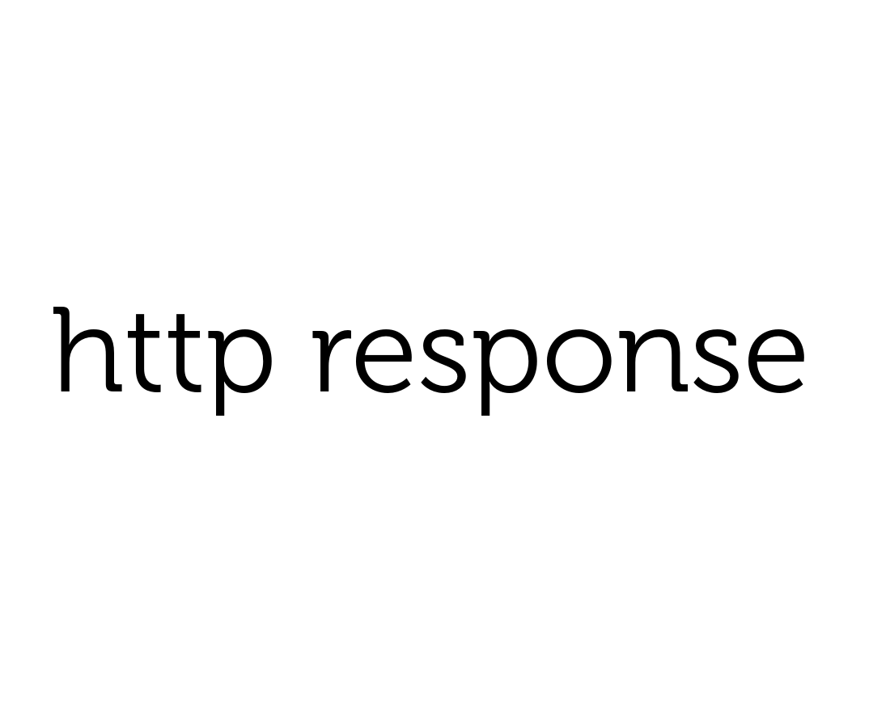
HOW IT WORKS

Slide 18
HOW IT WORKS
Step 1: test the consumer
Mock

Slide 19
HOW IT WORKS
Step 1: test the consumer
Mock
GET /orders/1234

Slide 20
HOW IT WORKS
Step 1: test the consumer
Mock
GET /orders/1234
{
“id”: 1234,
“items”:[
...
],
}

Slide 21




HOW IT WORKS
Step 2: share the contract with the Pactflow
Mock

Slide 22
HOW IT WORKS
Step 3: test the provider
Mock
GET /orders/1234

Slide 23
HOW IT WORKS
Step 3: test the provider
Mock
GET /orders/1234
{
“id”: 1234,
“items”:[
...
],
}

Slide 24
HOW IT WORKS
Step 3: test the provider
Mock
✔︎
Notes:
Results are shared back to the broker

Slide 25
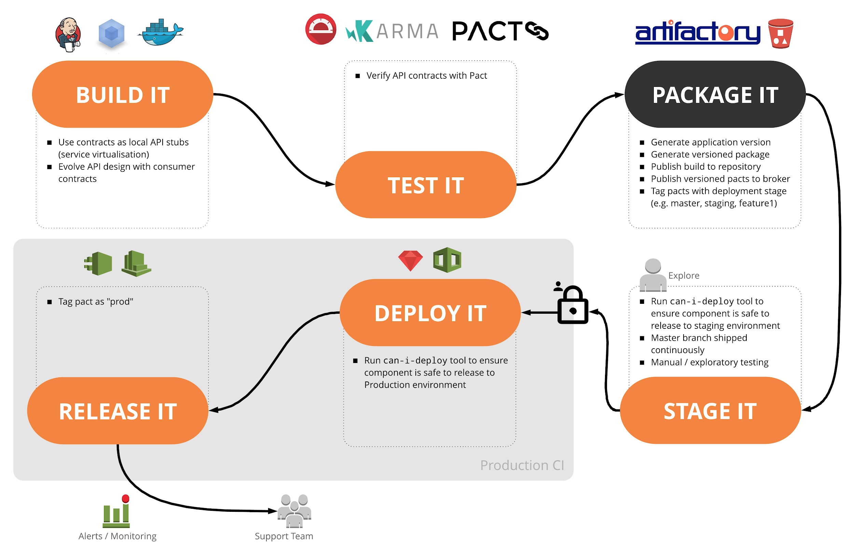
HOW IT WORKS
Step 4: hook into your CI and CD

Slide 26
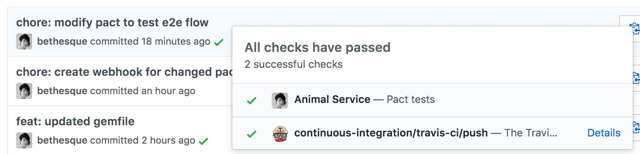
HOW IT WORKS
Step 4: hook into your CI and CD

Slide 27
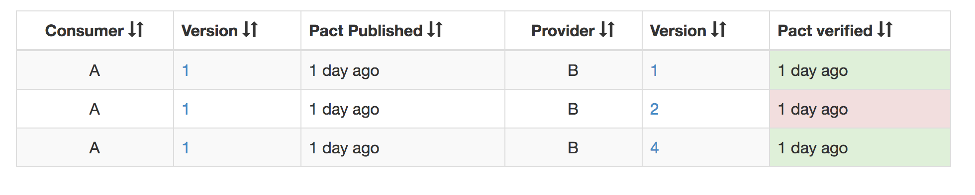
HOW IT WORKS
Step 4: hook into your CI and CD
$ pact-broker can-i-deploy
--app A --version 1
--to prod

Slide 28
DEMO
DEMO
Use case: React Product Catalog
Consumer pact workflow
Update /product/:id endpoint test
Show how consumers can work independently
Publish
Verification Results
Provider workflow
Brought to you by

Slide 29
DEMO: PRODUCT CATALOG
Product Consumer
JSON/HTTP
Product API
Brought to you by

Slide 30

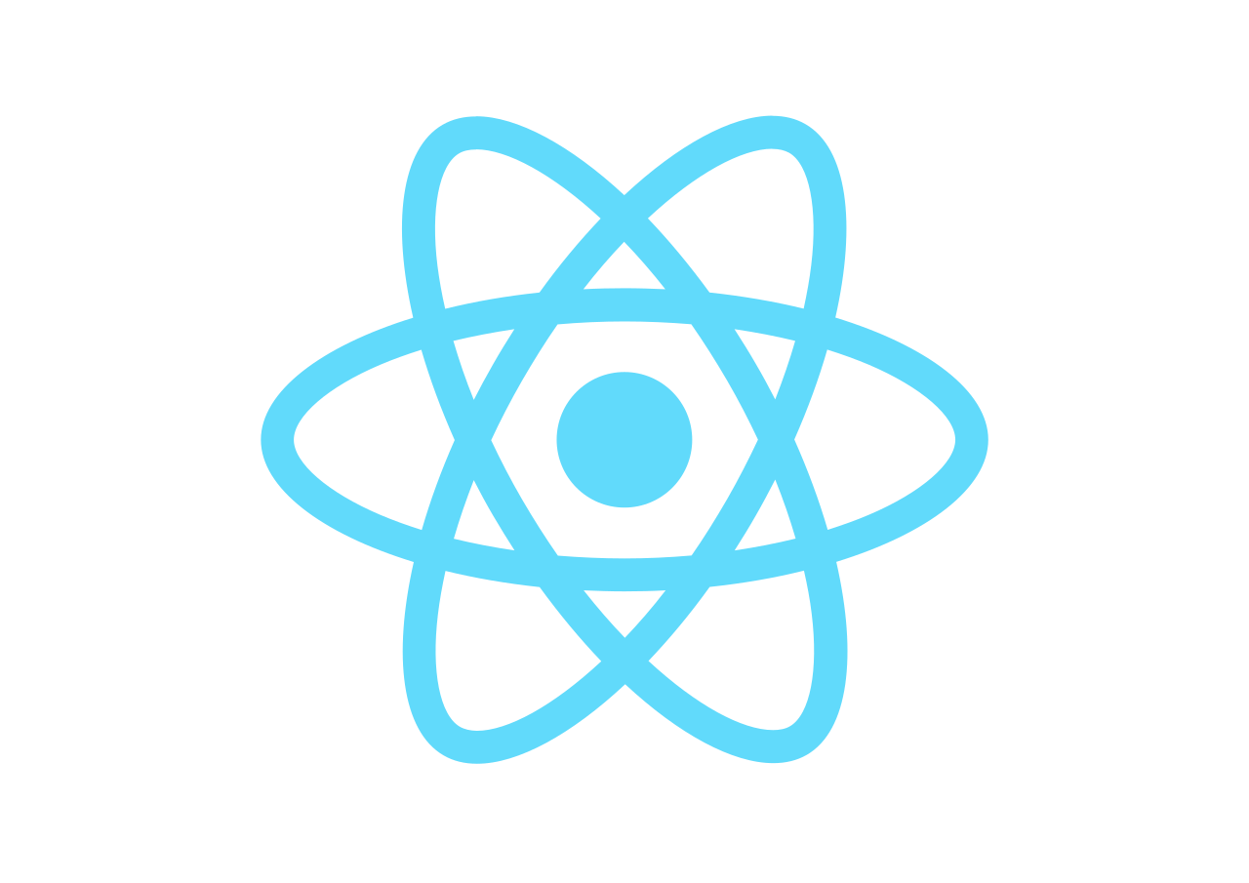
DEMO: PRODUCT CATALOG
JSON/HTTP
Product API
Brought to you by

Slide 31
DEMO: PRODUCT CATALOG
JSON/HTTP
Product API
Brought to you by

Slide 32
DEMO: PRODUCT CATALOG
JSON/HTTP
Product API
Brought to you by

Slide 33
DEMO
DEMO
Use case: Kafka
Consumer pact workflow
Add new /products endpoint test
Show how consumers can work independently
Publish
Verification Results
Provider workflow
Brought to you by

Slide 34


DEMO: KAFKA
Producer A
Consumer X
Producer B
Consumer Y
Producer C
Consumer Z
Brought to you by

Slide 35
DEMO: KAFKA
Event API
Pact
Pact
Product API

Slide 36
REST APIs
JSON/HTTP
GraphQL/HTTP
API Gateway / BFF
JSON/HTTP
JSON/HTTP
Microservice A
Microservice B
JSON/HTTP
Microservice C
JSON/HTTP

Slide 37

SERVERLESS
JSON/HTTP
JSON/HTTP
API Gateway
JSON/HTTP
Microservice A
Microservice B
Microservice C

Slide 38
Scope of consumer test
HOW IT WORKS: CONSUMER
Adapters
Services
Domain
External Service
Collaborators
Repositories

Slide 39
Scope of Provider Test
HOW IT WORKS: PROVIDER
Adapters
Services
Domain
mock
Collaborators
Repositories
In-memory database

Slide 40











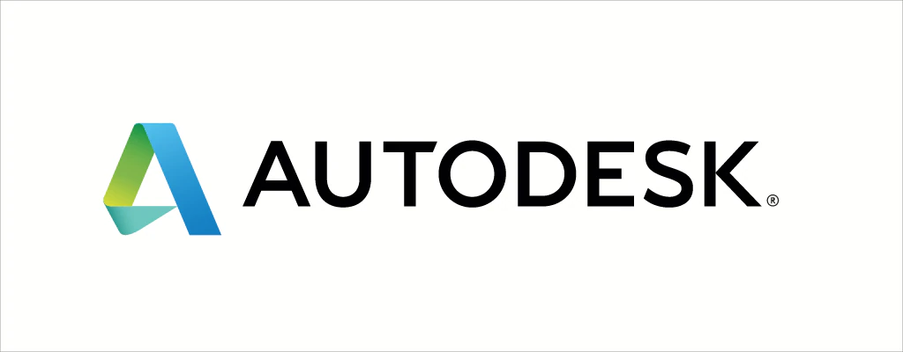











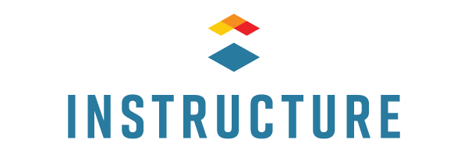



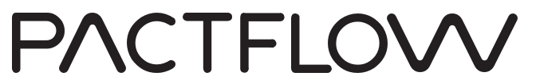

WHO’S USING PACTFLOW?
Finance fintech and neo-banks
Insurance b2b and consumer
Retail and consumer
Technology high-tech and startups
Logistics and supply chain
Marketing technology
Education and online learning
Health and medical technology
Brought to you by

Slide 41
PRODUCT
Pactflow
Contract testing at scale
Additional Capabilities
Fully managed platform + hardened for scale
Better user experience
Secure access management
Collaboration and insights
Expansion to other integration technologies*
* 2020 Roadmap
Security, Identity + Access Management
Collaboration
Tools
Intelligence
Integrations
MQ
Protocols
Broker
Insights
Pact + OSS Tooling

Slide 42
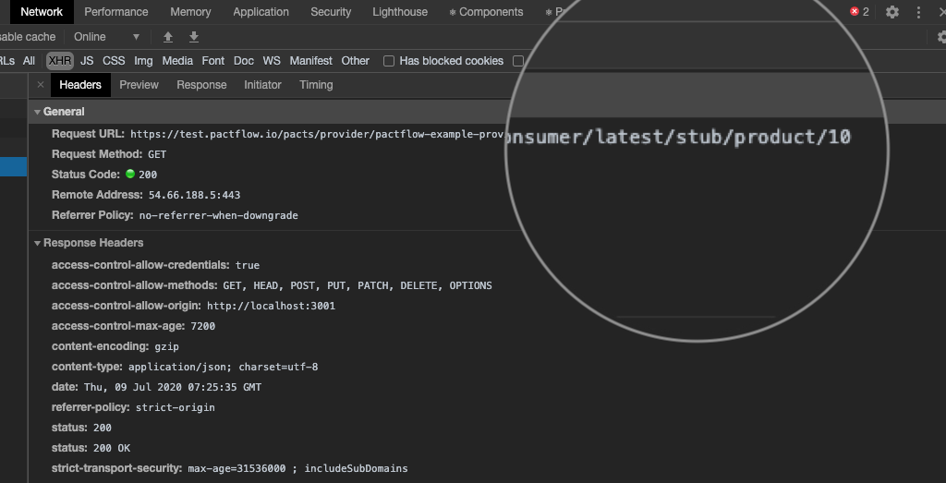
FEATURES
Features
Instant API Stubs
Replace fragile test environments with lightning fast + reliable hosted stubs
Instant API backend for all contracts
Reliable environment for UI e2e tests
Simplify local development against multiple backends
Discover and explore other APIs
Find out more at pactflow.io/blog/hosted-stubs/
Brought to you by

Slide 43
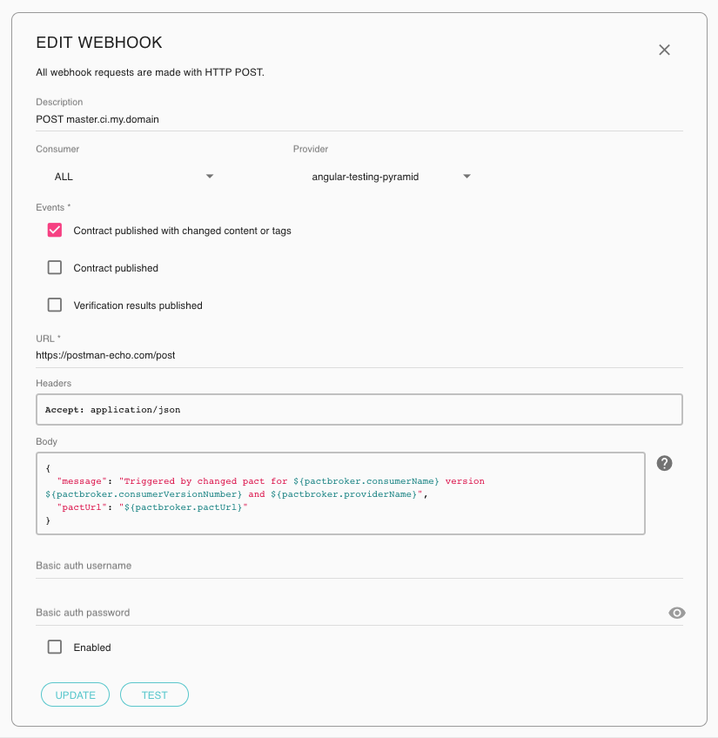
FEATURES
Features
Webhooks
Orchestrate complex build, test and deployment pipelines.
Trigger a build on your CI (such as Travis or Bamboo)
Publish your commit status to GitHub
Notify your teams via Slack of a change to a contract
Find out more at pactflow.io/blog/webhooks/
Brought to you by

Slide 44
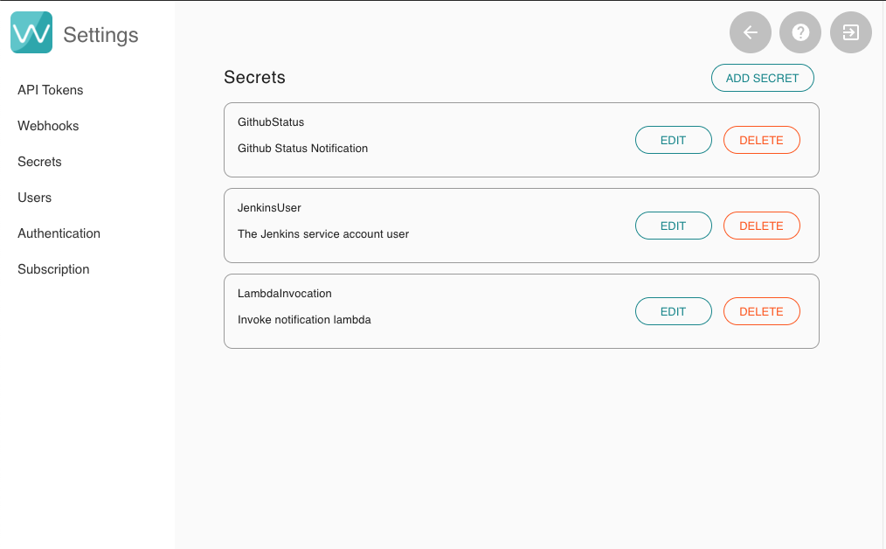
FEATURES
Features
Secrets
Manage sensitive information with our Secrets Management
All secrets are:
Encrypted with customer specific keys
Redacted in all log files
Hidden from all users in the UI
Find out more at pactflow.io/blog/secrets/
Brought to you by

Slide 45
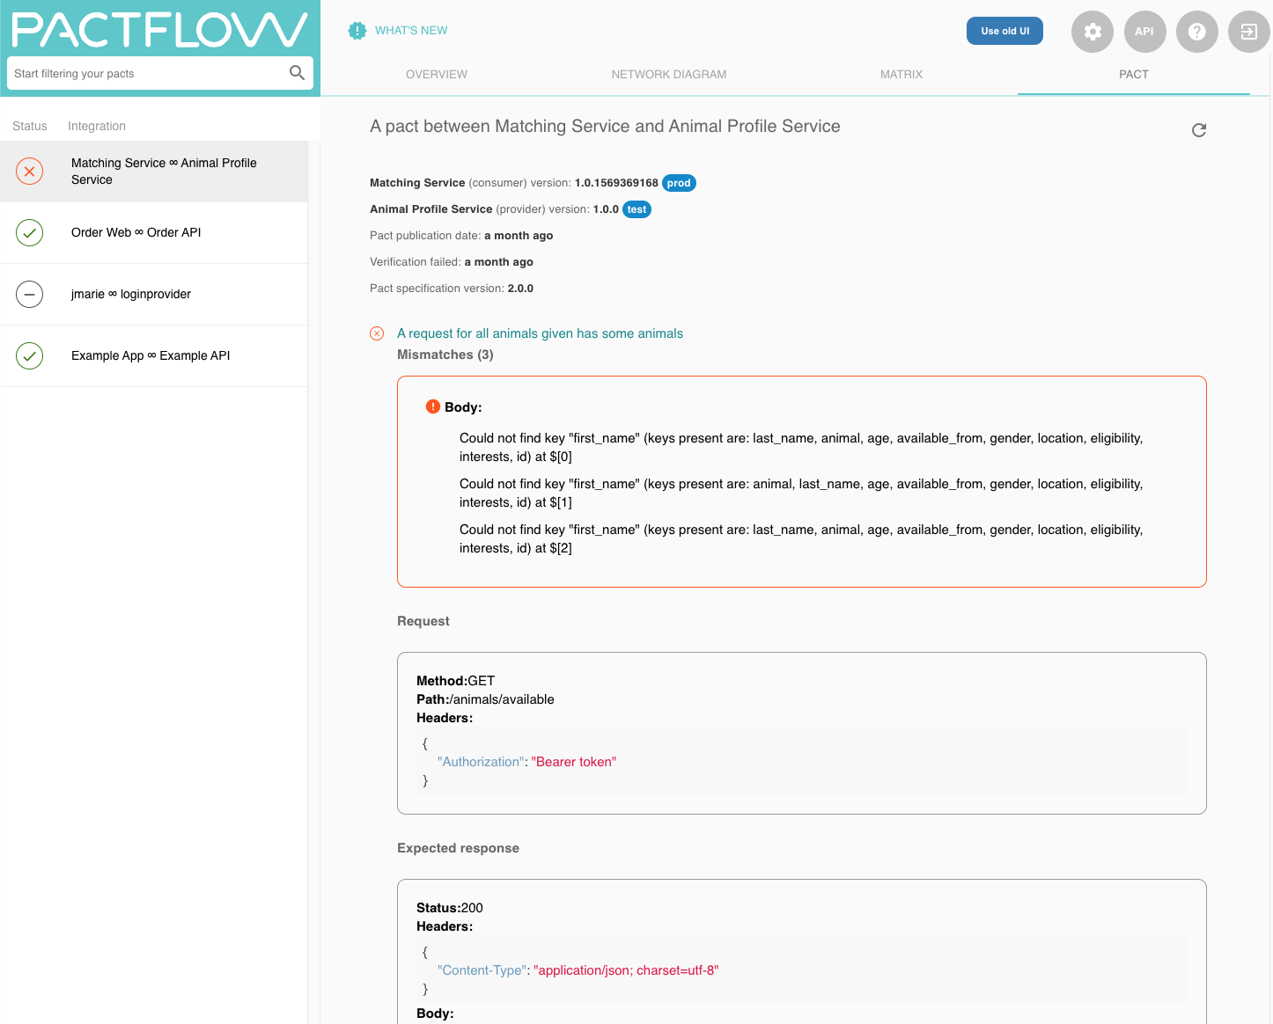
FEATURES
Features
Verification Results
Understand build failures with detailed error reporting via Verifications:
Give visibility to consumer teams and reduce time-to-diagnosis
Breakdown of successful and failed interactions
Understand which field, header or status code was the cause of the problem
Find out more at
pactflow.io/blog/verification-results/
Brought to you by

Slide 46
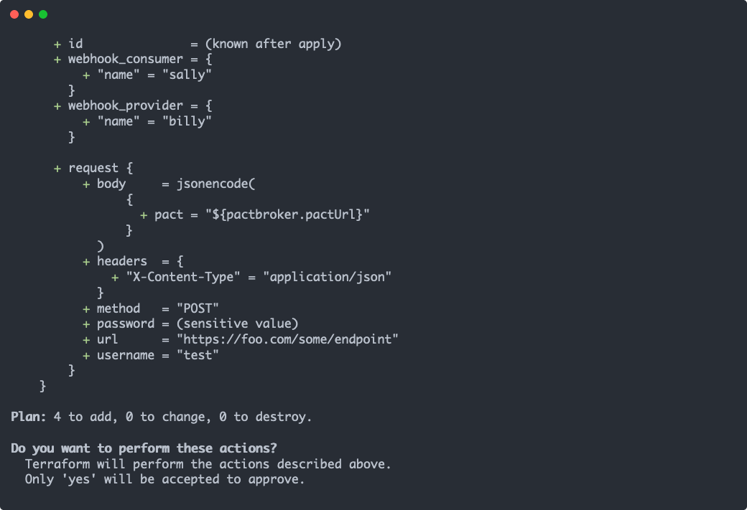

FEATURES
Features
Infra-as-Code
Automate your Pactflow configuration with Terraform:
Pacticipants
Webhooks
Secrets
API Tokens
Find out more at https://pactflow.io/blog/terraform/
Brought to you by

Slide 47
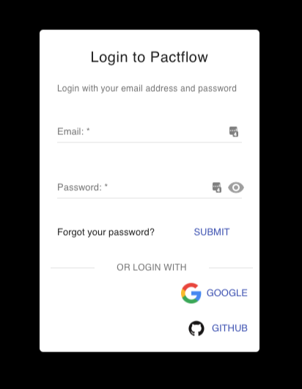
FEATURES
Features
Social Login, SSO and SAML 2.0
Choose how you want to authenticate and manage your users:
Pactflow’s in built user database
Github authentication ¹
Google OpenID connect ¹
SAML ²
Find out more at
pactflow.io/blog/saml-and-federated-authentication/
¹ Available on Team or Business plans
² Available only on Business plans
Brought to you by

Slide 48
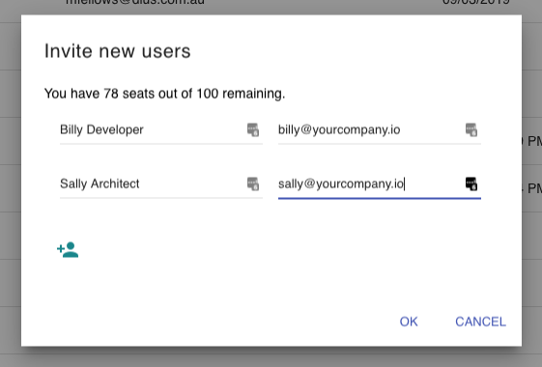
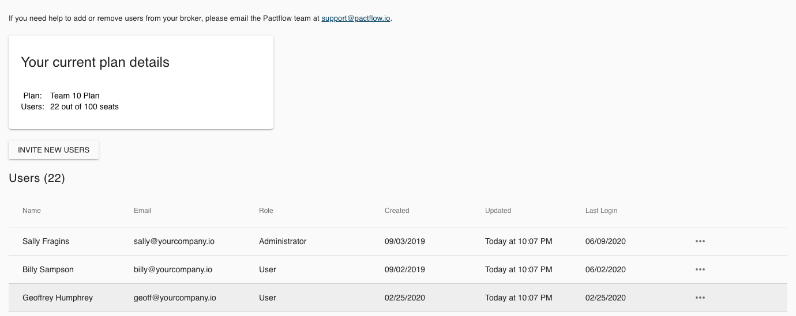
FEATURES
Features
User Management
Manage your team and access:
Invite new users
Review login activity
Assign roles
Disable access
Find out more at https://pactflow.io/blog/users
Brought to you by

Slide 49
FEATURES
Features
Audit Log
{
"events": [
{
"uuid": "16WlpdLpDMzfMYxLTZYXYw",
"timestamp": "2019-12-10T09:15:24.864+11:00",
"type": "SaasBroker::Api::Resources::RegenerateApiToken",
"db_user_id": 2,
"user_email": "someuser@somecompany.com",
"payload": {
"path": "/settings/tokens/_UjhYvyyEjM9L2SgWd0qsw/regenerate",
"queryString": "",
"method": "POST",
"userAgent": "Mozilla/5.0 (Macintosh; Intel Mac OS X 10_14_4) Appl",
"referer": "http://somebroker.pact.dius.com.au/settings/api-tokens",
"params": {
"resource_name": "regenerate_token",
"token_uuid": "_UjhYvyyEjM9L2SgWd0qsw"
}
}
},
...
],
"_links": {
"self": {
"href": "http://somebroker.pact.dius.com.au/audit?from=zHO0xNcjUseyU6DsisadXw"
},
"next": {
"href": "http://somebroker.pact.dius.com.au/audit?from=IlECUSbMLJLOy8gFbLLuIg"
}
}
}
Integrate Pactflow into your SOC:
Immutable audit log available via API
Full traceability of access and system usage, including references to IdP identities
Available to Business Plans
Find out more at
pactflow.io/blog/audit-api/
Brought to you by

Slide 50
PRODUCT
What’s next for Pact?
Modern APIs
Websockets
GraphQL
New Capabilities
Distributed systems are increasingly more complicated, and enterprises need a solution to polyglot integration technologies:
Real-time web apps (Websockets, GraphQL)
Event-based architectures (Kafka/Avro)
High-performance microservices with gRPC and Protobufs
Function-as-a-Service (e.g. lambda)
Legacy SOA apps with SOAP/XML
Cypress integration
External APIs
JSON/HTTP
Microservice D
Microservice F
Avro/tcp
Protobufs/gRPC
External API
Microservice E
Microservice G
JSON/HTTP

Slide 51




Team
Email: hello@pactflow.io
Web: pactflow.io
Twitter: @pactflow
Matt Fellows - Founder + JS/Go/Rust Maintainer @matthewfellows
mfellows@dius.com.au
Beth Skurrie - Founder + Ruby Maintainer/Pact Broker Creator
@bethesque
bskurrie@dius.com.au
Ron Holshausen - Founder + Pact JVM/Rust Maintainer @uglyog
rholshausen@dius.com.au
Brought to you by

